Slide 1
Python Programming Basics

Slide 2
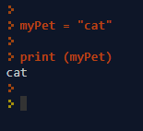
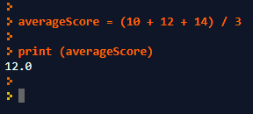

Assignment Statements
The symbol “=“ means assign a value
The symbol “==“ means is equal to
We will discuss this later

Slide 3
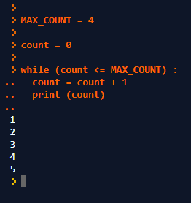
Variables & Constants
Constant: An identifier that is assigned a value that does not change in the program
Variable: An identifier that can change value during program execution

Slide 4
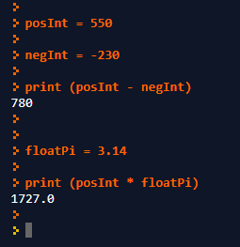
Data Types
Integers (32767 to -32768)
Whole Numbers
Limited Range
Floating Point (Decimal Points)
Real Numbers
Unlimited Range

Slide 5
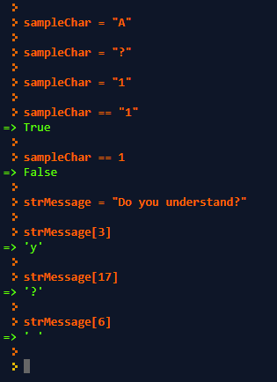
Data Types
Characters
A single alphanumeric character
Also includes punctuation marks
Note: : “1” is NOT the same as 1
Strings
A series of characters
Used to store messages or user feedback

Slide 6
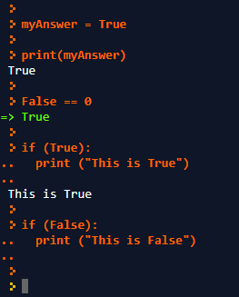
Data Types
Booleans
Has a value of either “True” or “False”
Used for computer logic & control
Known as Binary Logic
1 is the same as True
0 is the same as False

Slide 7
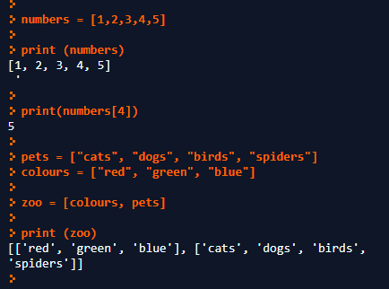

Data Types
Lists
An ordered series of objects
The objects may be any data type
List Index
Items in the list may be accessed using the [] index
Note: The index starts at 0
Lists of Lists
Lists may also contain sub-lists

Slide 8
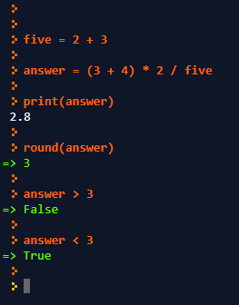
Math Operations
Basic Math
+, -, *, /, ()
Built in Functions
round(), abs(), sqrt(), etc.
Comparison
<. <=, >, >=, ==, etc.

Slide 9
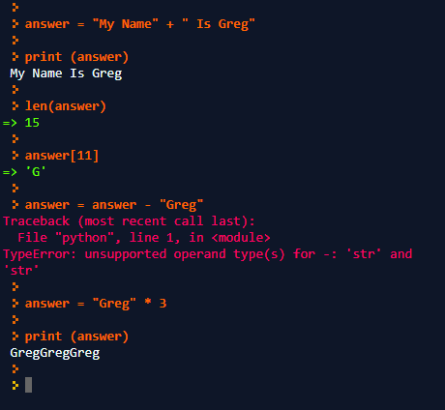
String Operations
Concatenation: “+”
Replication “*” also works
Note: -, /, do not work
Built In Functions
len(), etc.
Indexing
Note: index starts at 0

Slide 10
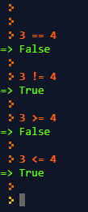
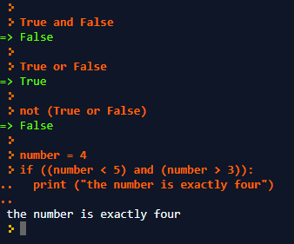
Boolean Operations
Equivalence
== and !=
Comparison
<, >, <=, >=, etc.
Binary Logic
and, or, not
NOTE: Don’t Use “+”, “-”, “*”

Slide 11
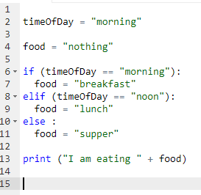
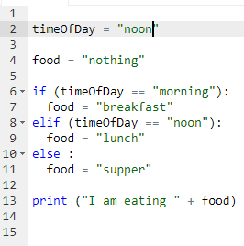
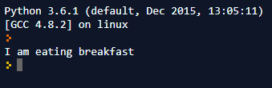
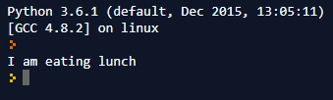
If Statements (Control Logic)
If statements are essential even for the simplest programs
They control which parts of a program are executed giver a set of conditions
If statements can be extended
Using “elif”
Using “else”

Slide 12
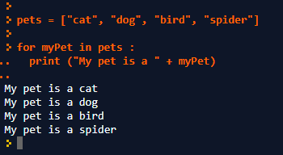
For Loops (Counted Iteration)
Loops are used when the same set of commands need to be repeated a number of times
For loops are useful repeating a known number of times.

Slide 13
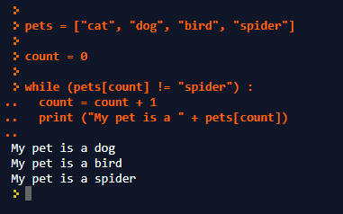
While Loops (Conditional Iteration)
Loops are used when the same set of commands need to be repeated a number of times
While loops are useful for repeating until a logical (Boolean) condition occurs

